Slide 1
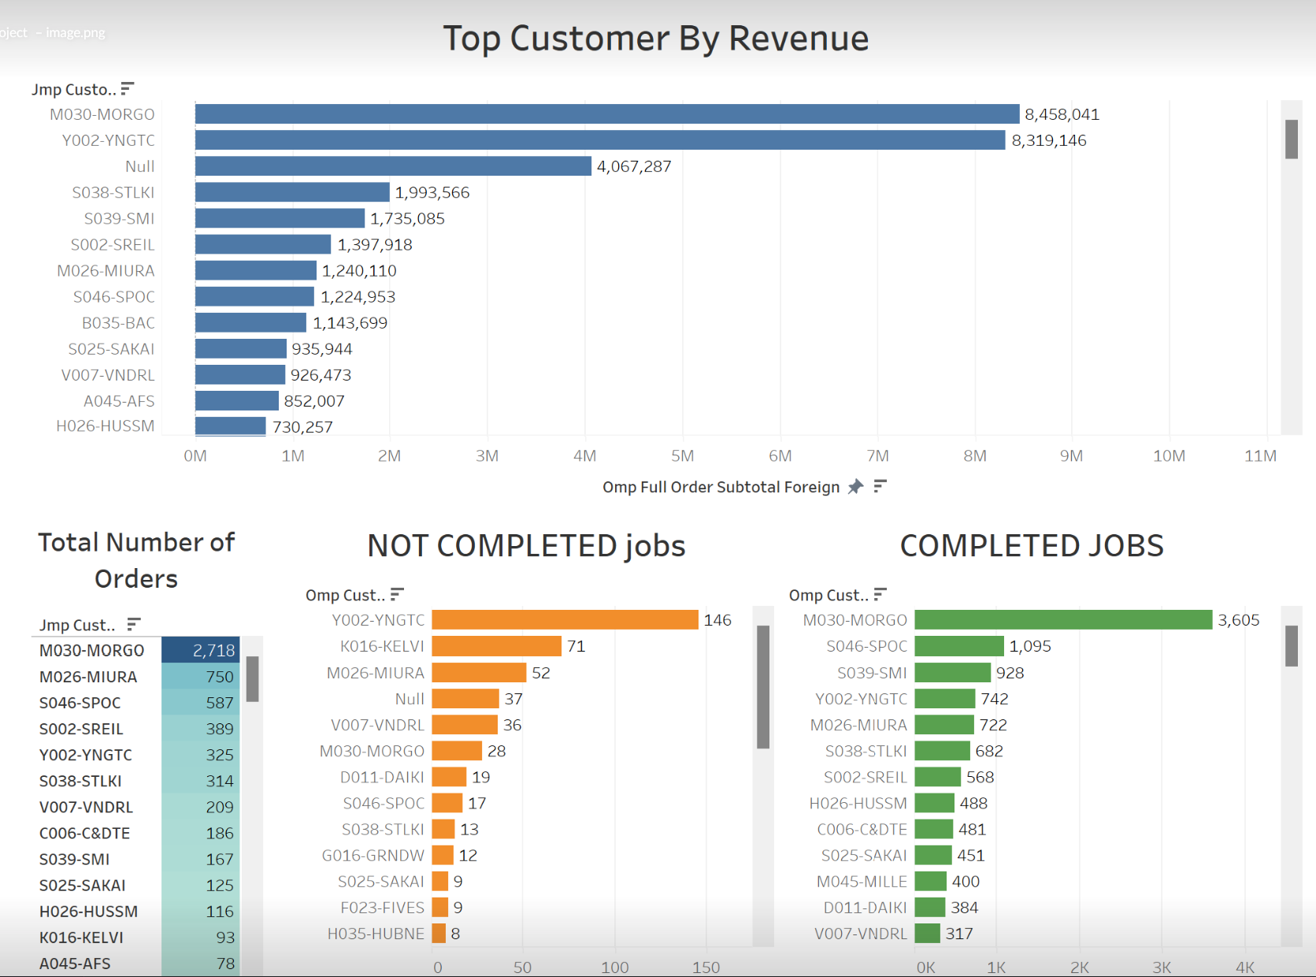
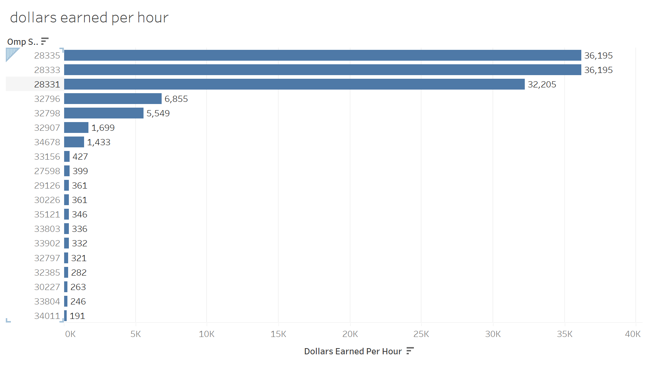
Revenue:
What customer generated the most revenue?
What order earned the most dollars per hour?
We have some interesting stats on completed job revenue vs not completed jobs.

